Slide 1
Update on: Direct Oral Anticoagulants (DOACS) and Stroke
Dr. Babak Kazemi, MD¹
Dr. Mehdi Farhudi, MD¹
Elyar Sadeghi Hokmabadi, MD¹
¹Tabriz University of Medical Sciences

Slide 2
Outline …
Pros and cons of DOACs
DOACs in AF secondary prevention (Dr. Kazemi)
DOACS and stroke (Dr. Farhoudi)
DOACS and CVST (Dr. Sadeghi)
Q & A

Slide 3
Disclosure
None (webinar is sponsored by Arvand Pharmed/CinnaGen)

Slide 4
Antithrombotic
Antiplatelets: ASA, Clopidogrel, Ticlopidine
Anticoagulants:
Non-oral (Heparin, LMWH)
Oral: Warfarin, NOACs (DOACs)
DOACs: Dabigatran, Rivaroxaban, Apixaban, Edoxaban

Slide 6
Pros and cons of DOACs
Pros
A predictable anticoagulant effect without need for routine coagulation monitoring (predictable pharmacokinetics)
Fewer food interactions compared with VKAs
Fewer drug interactions compared with VKAs
Rapid onset/offset of action, no need for bridging
Lower risk of intracranial bleeding

Slide 7
Pros and cons of DOACs
Cons
Requires strict compliance, because missing even a single dose could result in a period without anticoagulation, medication adherence without laboratory monitoring
Higher drug costs compared with warfarin
Absence of specific antidotes for DOACs
No data for their use in the presence of mechanical heart valves
No data for their use in pregnant or lactating women

Slide 8
(DOACs) and CVT
Elyar Sadeghi Hokmabadi, MD
Tabriz University of Medical Sciences

Slide 9
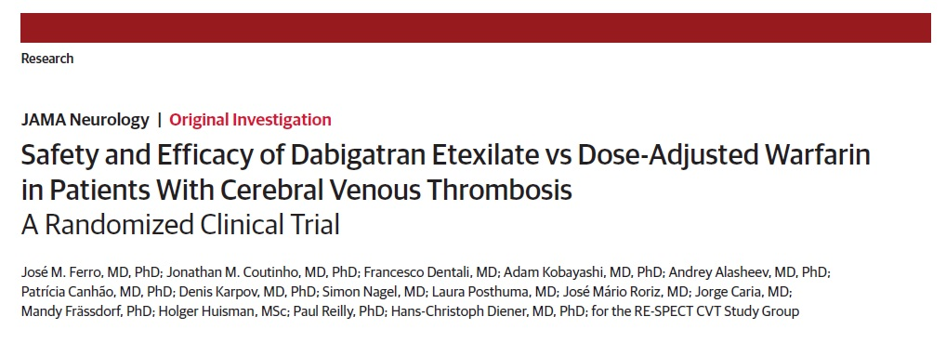

Slide 10
Methods
RE-SPECT CVT is an exploratory, multicenter PROBE design (prospective, randomized, parallel-group, open-label with blinded evaluation of end-points) clinical trial conducted at 51 sites in 9 countries (France, Germany, India, Italy, the Netherlands, Poland, Portugal, Russia and Spain) from December 21,2016, to June 22, 2018.
Between 18 and 79 years of age

Slide 11
Methods
Major exclusion criteria:
The inability to swallow oral medication
CVT associated with central nervous system infection or major head trauma
Planned surgical procedure for CVT(eg, decompressive hemicraniectomy)
Life-threatening or major bleeding in the previous 6 months other than intracranial hemorrhage from the index CVT
Current or recent (<6 months) malignancy
Creatinine clearance level less than 30 mL/min
The allocated sample consisted of CVT cases of mild to moderate severity

Slide 12
Methods
Randomization:
Patients were randomized 1:1 through an online telephone-guided Response system to receive either dabigatran (150mg twice daily) or warfarin (dose adjusted to maintain an international normalized ratio [INR]between2.0and3.0).

Slide 13
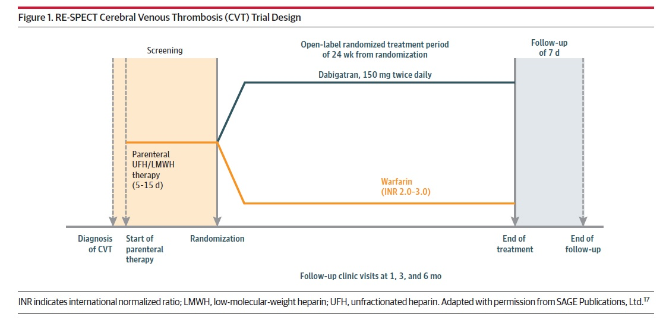
Methods

Slide 14
Methods
The trial consisted of 3 sequential periods: a screening period of 5 to 15 days, a treatment period of 24weeks, and a follow-up period of 7 days.
Randomization occurred 5 days after the start of parenteral anticoagulation therapy if the patient was stable, but it could be postponed until the patient was stable for up to 15 days after the start of parenteral therapy

Slide 15
Methods
The primary outcome:
The composite of the number of patients with major bleeding or VTE (recurrent CVT, DVT of any limb, PE, or splanchnic vein thrombosis), at the end of the trial.

Slide 16
Methods
RE-SPECT CVT was an exploratory trial.
Based on expected recruitment rates, we planned to randomize 120 patients. Planning RE-SPECT CVT as a non-inferiority trial with a preservation of about 50% of the recurrent events would require more than 2000 patients because of the low recurrent event rate (approximately 3% at 6 months).

Slide 17
Methods
In total, 120 patients with CVT were randomized to the 2 treatment groups (60 to dabigatran and 60 to dose-adjusted warfarin).
For warfarin, the overall mean time in therapeutic range was 66.1%.

Slide 18
Results

Slide 19
Conclusion
These results are in line with evidence that dabigatran is at least non-inferior in efficacy compared with warfarin in indications other than CVT, presenting fewer bleeding events, specifically intracranial hemorrhages.

Slide 20
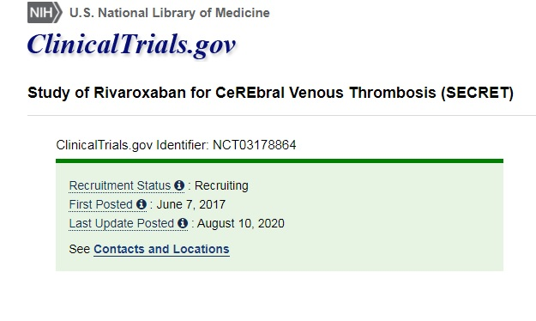

Slide 21
SECRET study
Sponsor:
University of British Columbia, Canada
Will be randomized to receive rivaroxaban 20 mg daily versus standard of care (warfarin or low-molecular weight heparin). Patients will be followed for 1 year.
Estimated Study Completion Date: December 2021

Slide 22
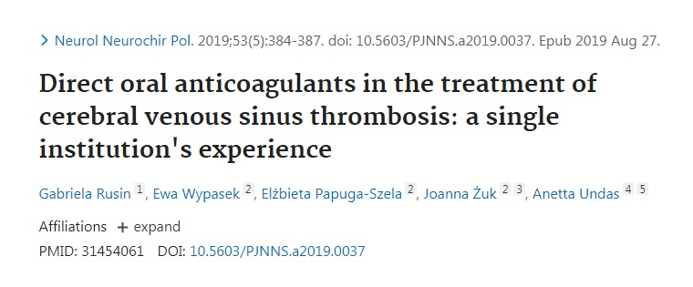
Apixaban for CVST

Slide 23
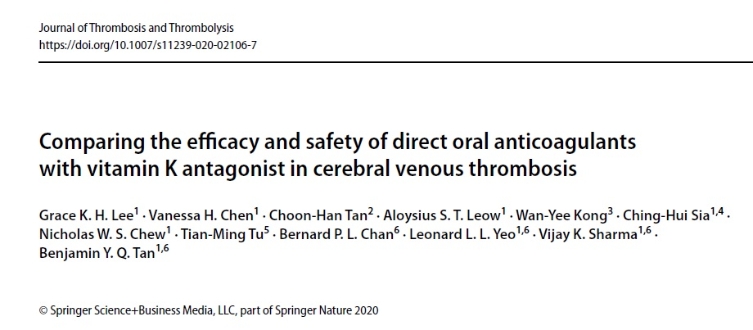

Slide 24
Systemic review and meta-analysis
The potential role of DOAC as a reasonable alternative to warfarin in the anticoagulation strategy for CVT. DOAC appears to be similar in efficacy, and may potentially result in fewer major bleeding events when compared to warfarin.

Slide 26
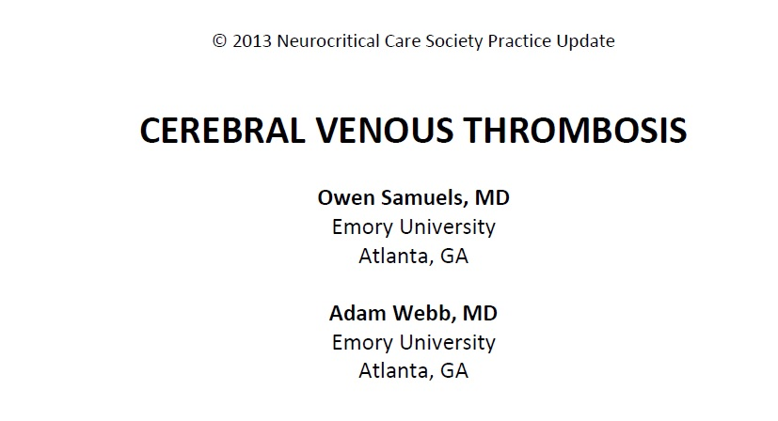

Slide 27
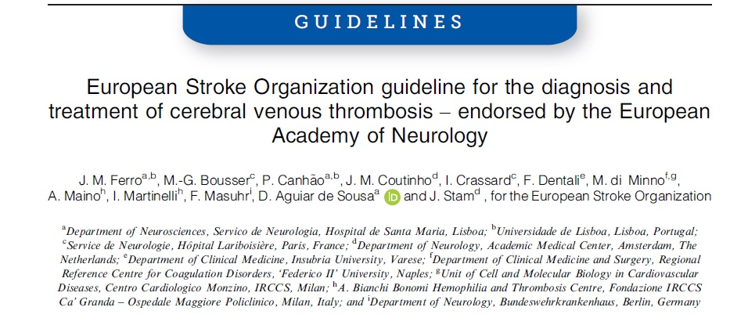

Slide 28
Conclusion
DOAC are a reasonable alternative to warfarin in the anticoagulation strategy for CVT (off label), but guidelines have not been updated yet.

Slide 29
Thanks for your attention

